Slide 2
Building Serious Mountain Scenery
Bruce DeMaeyer
MCR Division 10
September 3, 2017

Slide 3
Layout Parameters
How much Space for Layout in Train Room
Choose your Layout’s Geographical Location
Determine Key Attributes of Layout
Identify Space locations of Attributes

Slide 4
High Level Layout Plan Attributes

Slide 5
My Key Attributes
Western Class 1 BNSF/Union Pacific/Montana Rail
Grain Processing
Small Oil Refinery
Small modern Town
Large Classification Yard, Maintenance Facility and small Intermodal Yard
Large Area dedicated to Mountains

Slide 6
Steps-Start to Finish
Decide where you are building your layout
Modular vs. Fixed
Determine how much space to dedicate to the mountains
Get really good, prototype photographs, in person or internet
Backdrop Design and Build
Define the supporting track plan
Build the track
How many major peaks, streams, bridges, etc.
Three dimensional model on a two dimensional topographical drawing
Mountain materials – foam, plaster rock casting, rubber rocks, and Sculptamold
Final sculpting, painting, water effects, landscaping

Slide 7
This Clinic Focuses on my Mountain Area
Choose your prototype carefully
Mountains come in many different flavors
Appalachians
Rocky Mountains
Big Hills
Iowa Prairie Dog Hill

Slide 8
My Choice of the Mountains
Glacier National Park Area in Northern Montana
Rugged Northern Rocky Mountain Area
Rugged, pine and deciduous tree covered
Heavily brushed slopes, grassy open areas
Avalanche areas – snowshed
Fast moving rivers
Hunting Camp

Slide 9
How much space is needed
To model western mountains it takes space
Steep slopes reduce space needs
Balance steepness against real world
N scale – 6’ x 8’, HO scale – 12’ x 16’
If you’re going to build serious mountains, do it right

Slide 10
Prototype Photos

Slide 11
Prototype Photos

Slide 12
Prototype Photos

Slide 13
Prototype Photos

Slide 14
Prototype Photos

Slide 15
Prototype Photos

Slide 16
Backdrop Design & Build
Installed my backdrop very early in my layout build, literally, the very first thing
Used mountain photo scenery from Backdrop Junction – Colorado Mountains
Vinyl sticky-back product
Installed onto ½” plywood screwed into wall studs

Slide 17
Supporting Track Plan Used Railmodeller Software

Slide 18
Determine the Physical location of your tracks
Establishes your base level x and y axis
Works best if you are using a 2D drawing application for your computerized track plan. I used Rail Modeller on my Mac Desktop computer.
Track separations and minimum radius turns determine maximum mountain height
Build the track base using either cookie cutter method or riser foam. I used the cookie cutter method

Slide 19
Cookie Cutter Risers

Slide 20
How did I do this

Slide 21
How Many Peaks
One major double sided peak, rising almost 27 inches with a second double sided peak, rising almost 24 inches on the same mountain, with a large cirque forming the avalanche area.
Lower rear buttes, 21 and 17 inches merging into the backdrop

Slide 22
Geological Sequence
Mountains
Streams
Trails
Rails and Roads

Slide 23
Topographic Mapping
Large Scale Detail
Quantitative representation of relief using contour lines (a line connecting places of equal elevation)
Depicts ground relief (landforms), drainage (lakes and rivers), transportation routes (rails, roads and trails, other man-made features.

Slide 24
Contour Map
Allows the designer to determine the X, Y, and Z location of every point in the scenery window
Contour lines are curves that connect contiguous points of the same altitude
Use 2” gradient points for N scale and 4” gradient points for HO Scale

Slide 25
Create your Contour Map
Creates the X and Y Axis with the Z axis shown as gradients on the drawing
I used 2” as my gradient separation, so in N scale, that represents about 25 feet

Slide 26
My Actual Contour Map

Slide 27
Mountain Materials
High Density Polyurethane Foam – 1” and 2”
Plaster Rock Casting
Rubber Rocks
Sculptamold
EnviroTex Lite (River Effects)
Silicone Caulking (Waterfalls)

Slide 28
Base Unit

Slide 29
Early Photo of Base Walls

Slide 30
Major Bridge over River in Base

Slide 31
Full View of Mountain Base

Slide 32
Cross Section Example Elk Butte and Hunting Camp

Slide 33
Build the Mountain Tops
Mountain tops consist of four separate units
Units are placed on the top of the base which is permanently attached to the bench work.
Three “portable sections” fitted on top of the base that can be removed from the layout to do landscaping work
River “section” is lightly glued to the base and forms a guide for the mountain tops to be finally positioned on the base

Slide 34
Four Modular Units Fred's Peak Elk Butte Town Butte River Section

Slide 35
Complete Mountain Cross Section

Slide 36
Nature vs. Man

Slide 37
Mountain Tops Added Before track, bridges and landscaping

Slide 38
Left Side of Fred’s Mountain Mountain Top Landscaping Mostly Completed

Slide 39
Back Side of Fred’s Mountain Mountain Top Landscaping Mostly Completed

Slide 40
Portable Modules An Easy Way to do Landscaping

Slide 41
Front Face of Elk Butte

Slide 42
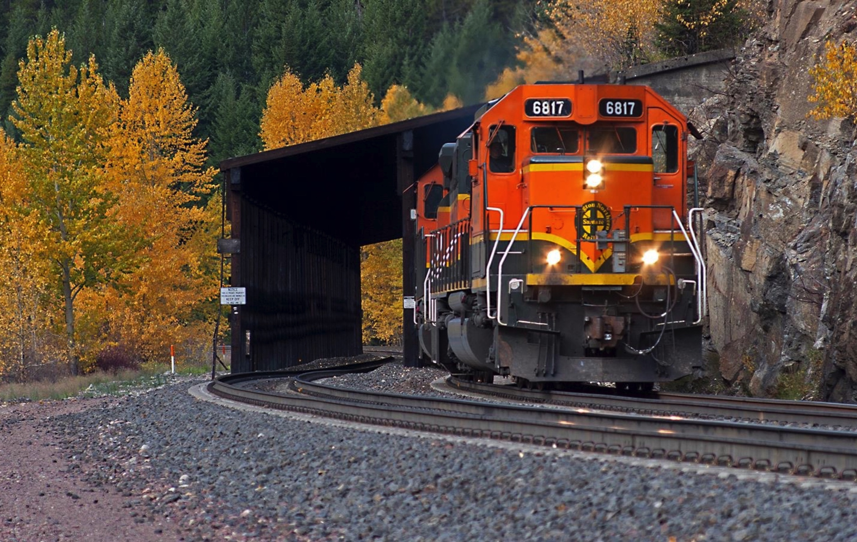
Snowshed Issue
Built the Snowshoe to GN Standard Design (1915)
Presented a clinic on this design to the division and at our Thoroughbred Unlimited 2015 convention
Need to find the perfect color of the shed, settling on tie brown with a light black wash.

Slide 43
Snowshed and Signal Bridge Prepainting

Slide 44
Shell Gas Station Issue
Limited Space
Lighting
Signage
Scratch-built Building and Pump center
Shapeways Pumps and Accessories

Slide 45
Shell Gas Station Scratch built

Slide 46
Hunting Camp

Slide 47
Final Detail Landscaping
Trees
Shrubs
Roadways
Ballasting
River
Rock Climbers
USFS Forest Horse Trail Bridges
Waterfall
Shell Gas Station
Vehicle Tunnel
Radio Tower
Hunting Camp
Horse Trail
Snowshed
Block Signal Masts

Slide 48
Future Plan
I intend, over the next couple of months, to finish the enhancements to the scenery model and then submit it for Merit Award judging in the AP Scenery category.

Slide 49
AP-Scenery Category
The completed section of the layout must contain the necessary scenic elements of Terrain, Structures, Background, Lighting, and Realism/Conformity as combined to achieve a realistic effect using applicable NMRA standards.

Slide 50
Scenery - Terrain
The ground and all natural features such as rocks, water, trees, shrubs, hills and depressions, as well as man made features such as railroad roadbed, cuts, fills, drainage ditches, embankments, streets and roads, etc.
Remember the detail on streets and roads, sewers / storm drains, shoulders, drainage ditches, cracks, patches, road wear marks, oil stains, and tire ruts in dirt roads.

Slide 51
Scenery - Structures
Structures are considered from the standpoint of prototypical suitability, placement, and appearance as scenic effects - NOT as to construction
This includes bridges, trestles, tunnels and culverts, buildings and all other types of structures (radio towers, signs, fences, retaining walls, etc.), track and right-of-way features such as snowsheds, signaling structures, and other service structures.

Slide 52
Scenery - Background
Treatment of the wall, backdrop, and/or ceiling to realistically depict depth, distance, horizon, and sky.
Your background should continue the 'illusion of reality ' that you are trying to create with your scenery. The background should match the scenery, and the transition where the two of them meet is smooth and/or hidden.

Slide 53
Scenery - Lighting
A fully day lit scene is perfectly acceptable (although you may get more points for a scene that allows you to show off more lighting elements). However, even in a day lit scene, there may be evidence of lighting - even if it is not operational.
Lighting elements such as vehicular tunnel lighting, radio tower flashers, commercial building lighting, and signal lighting all apply.

Slide 54
Scenery – Realism/Conformity
In the other four judging areas, the judges evaluate what you were trying to do - what you remembered to include in your scene. In this one, they evaluate how well you did what you were trying to do.
Your entire layout does not have to be completed to be judged - just enough to meet the minimum space requirements given above. However, the areas which are not to be judged should be blocked off (visually) from those that are.

Slide 55
Copy on Division Webpage
For a copy of this presentation, go to the Division Webpage:
https://nmramcrdiv10.yolasite.com/Modeling

Slide 56
Wrap Up
Any questions?

