Slide 1
JMRI 101 Part 0 : Overview
Mark Underwood, Jan 6 2019

Slide 2
JMRI Features and Components
JMRI is a Toolbox
Multiple independent but related tools in one package
Use what you want, leave the rest
Grow or change your JMRI usage as needed

Slide 3
Major Components
DecoderPro
Decoder programming and Roster management
PanelPro
Layout Panels, Signals, Turnouts, Routes, etc.
OperationsPro
Car tracking, forwarding, switch lists, manifests, etc.
DispatcherPro
Automation and online dispatching
SoundPro
Tools for using audio on the layout

Slide 4
Hardware Support
Runs on all major platforms (Windows, MacOS X, Linux)
Windows 7-10 and Vista SP2, MacOS X “Lion” through “Mojave”, Linux with Java 1.8 or newer
Older versions of JMRI are available to run on older PCs
JMRI supports almost any hardware system that has a computer interface
All major (and most minor) DCC systems
Many other systems (C/MRI, CTI TrainBrain, LCC, RailDriver, etc.)
Specialty hardware (RFID, location systems, Xbee, etc.)
Hardware Support Documentation:
http://jmri.org/help/en/html/hardware/index.shtml

Slide 5
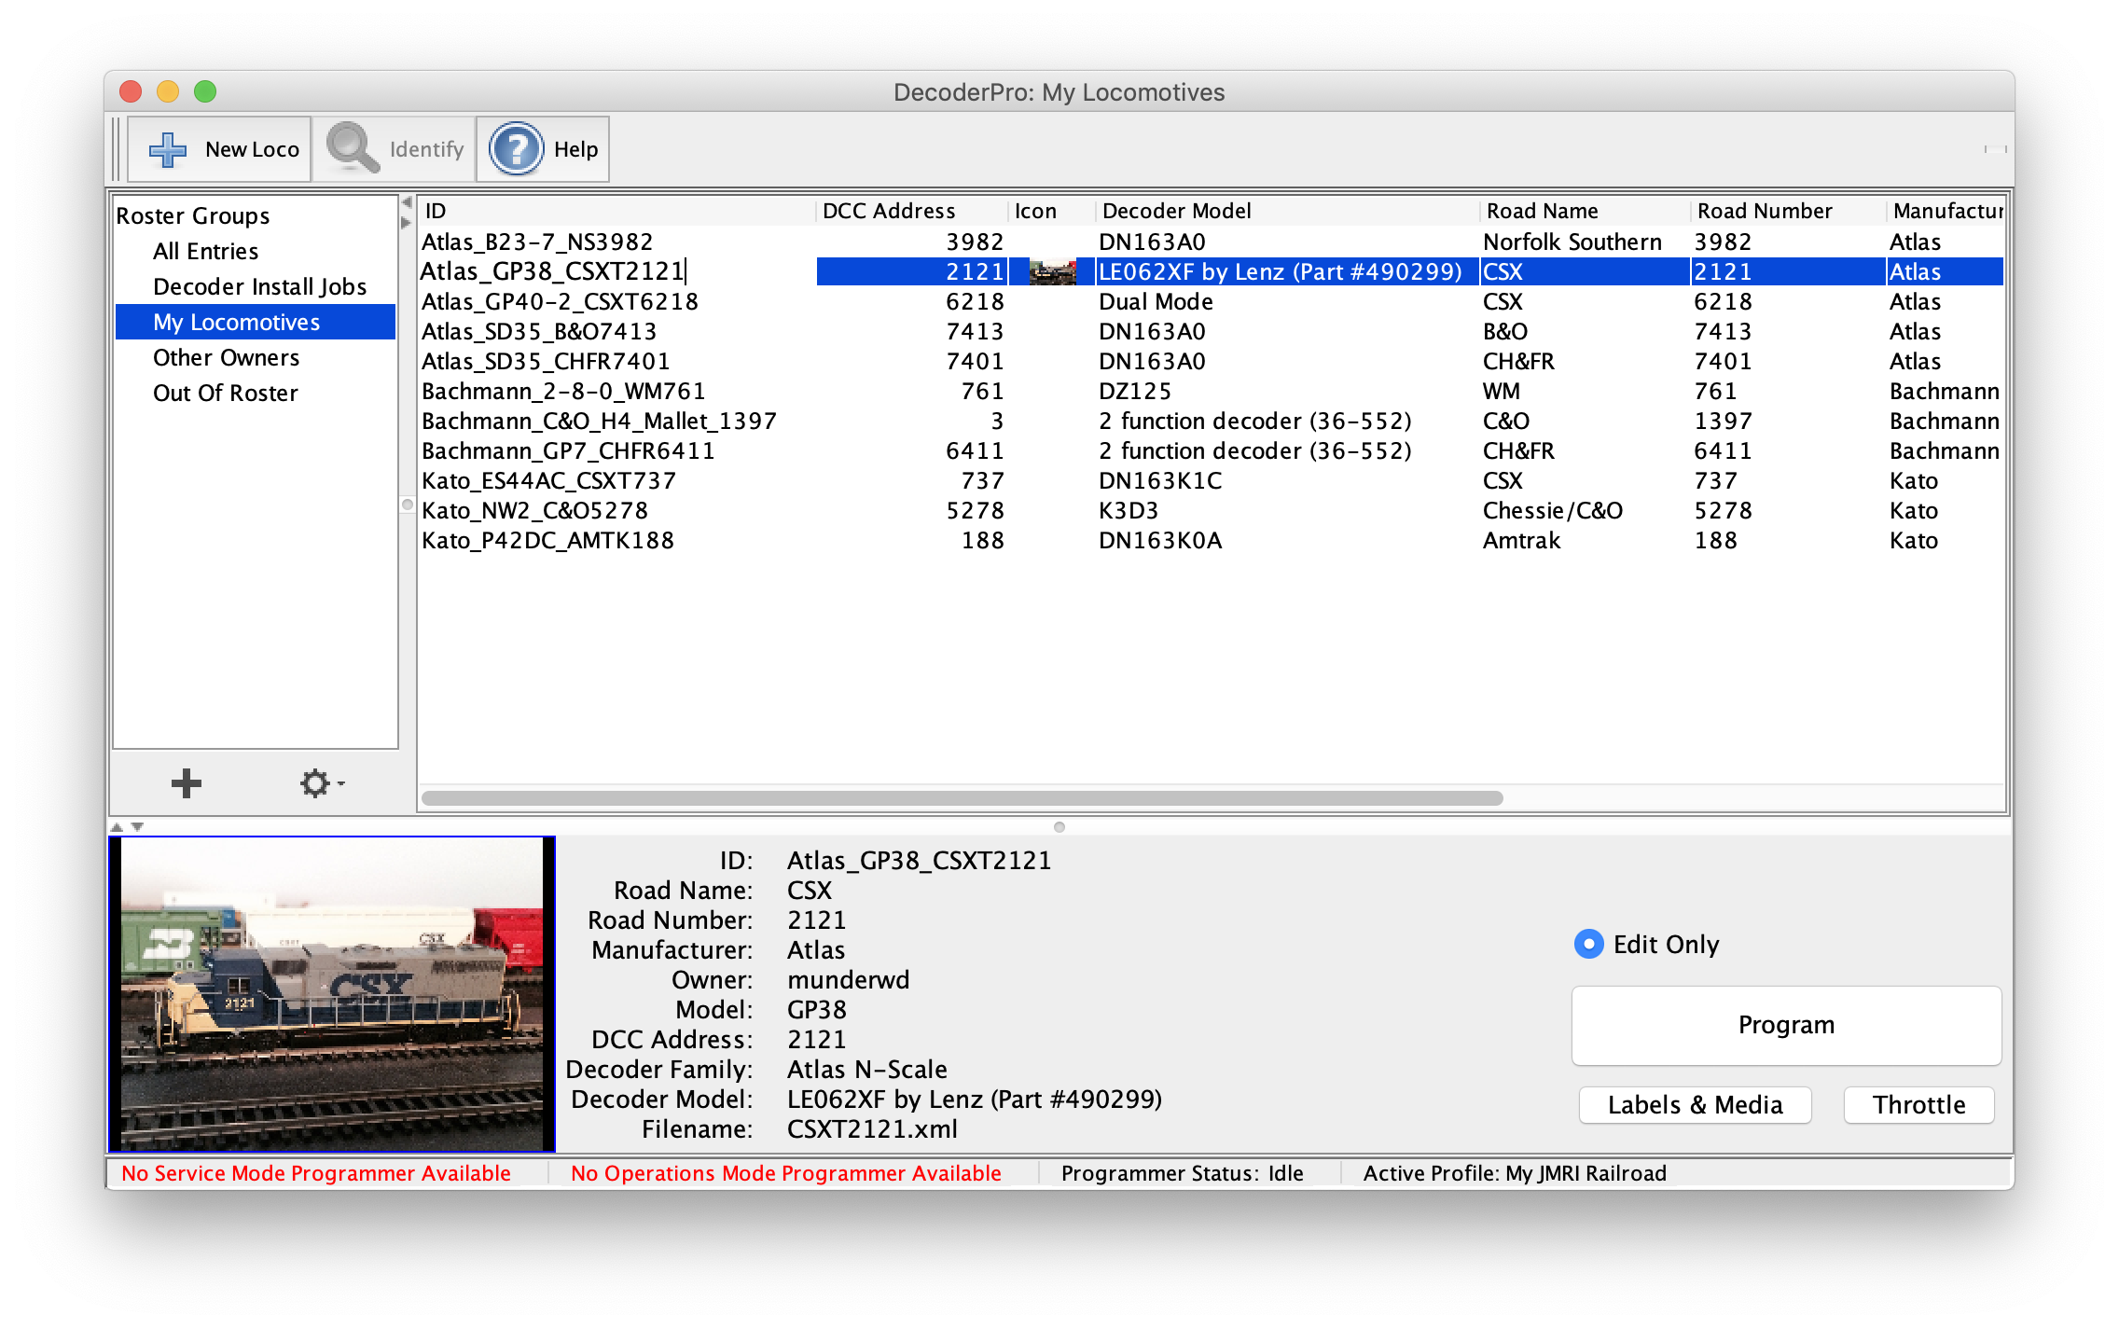
DecoderPro
Easy to use features
User-friendly dialogs for setting options
No need to memorize or calculate CVs or SVs
Supports an impressive list of decoders from all major manufacturers
Manage locomotive consists easily
Roster management
Keep track of your locomotives
Store, duplicate, modify configurations
Group locos by type, owner, decoder, or any other parameter

Slide 6
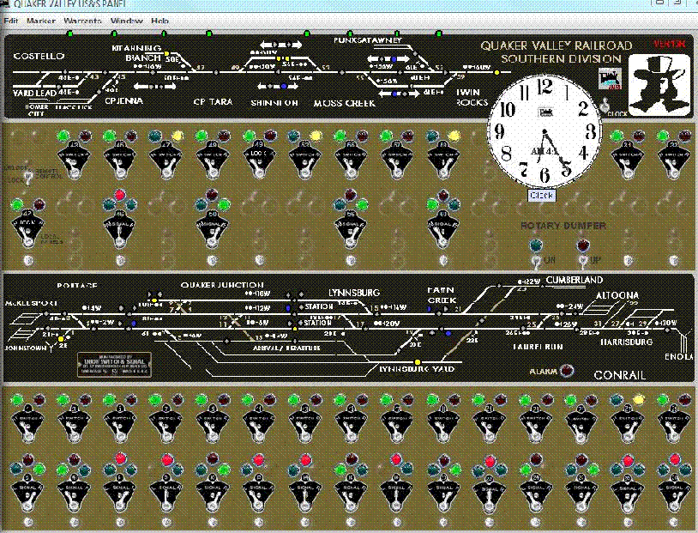
PanelPro
Create a variety of panel types, from classic CTC style to layout schematics
Control signals, turnouts, blocks, routes, and accessories
Design panels to suit your visual preferences
Manage components from multiple systems (DCC, LocoNet, LCC, etc.)

Slide 7
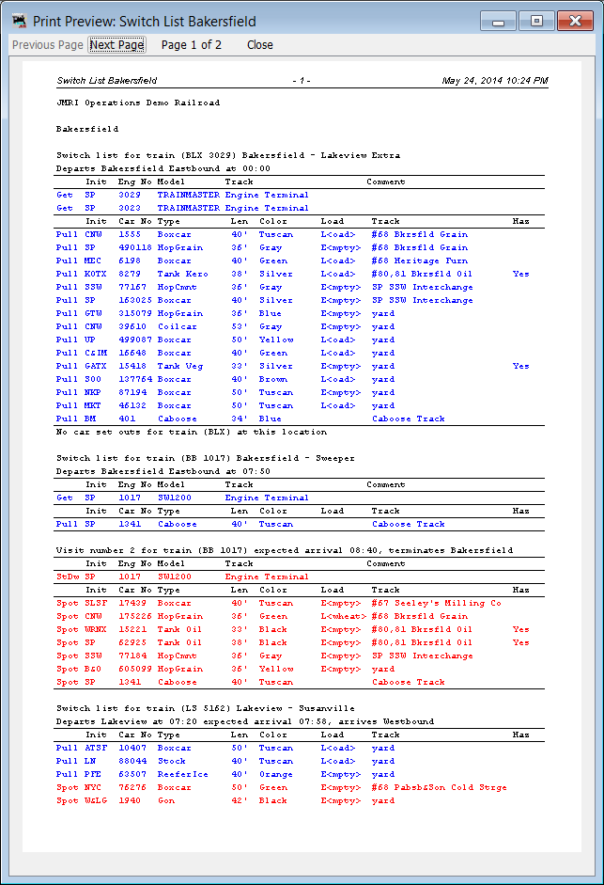
OperationsPro
Manage your railroad paperwork
Locations, routes, schedules, cars, trains
Print realistic switch lists and manifests
Track car locations and loads
Keep inventory of cars and locomotives
Move cars on simple or complex schedules
Handle complex systems like off-spots, staging, track pools, etc.

Slide 8
Dispatcher Pro and Sound Pro
DispatcherPro
Automated train operations
Can schedule trains to stop, start, route, and move on their own
Requires suitable sensors, turnout control and train control hardware
SoundPro
Control sound effects for the layout
Played through the computer’s audio system
Sounds can be triggered by any events (sensors, turnouts, clocks, etc.) in JMRI

Slide 9
Other Tools
Logix
Monitor layout state and take action on certain conditions
Intuitive, but powerful interface for specifying decision making
Signaling
Built-in support for realistic, prototypical signal systems
Simple Signal Logic (SSL) makes setup easy for most common systems
Routes
Set up paths through the layout (e.g. Staging to Smith Junction)
Automatically trigger turnouts, signals, sound effects, etc.
Fast Clocks
Speedometers

Slide 10
Connectivity / Remote Ops
Built-in Web Server
Can access most JMRI windows (panels, etc) through a browser
Web-optimized version of roster
Web-based throttles
LocoNetOverTCP
Can run a remote instance of JMRI as though connected directly to layout
WiThrottle Server
Support an (effectively) unlimited number of smart phone throttles

Slide 11
Thank You
For more information:
JMRI Website: https://jmri.org
JMRI User’s Group: https://groups.io/g/jmriusers
Me (msunderwd@gmail.com)

