Slide 1
Car Modeling Lessons from Newbie Mistakes
Harold Weinberg
NMRA Mid-Central Region, Div. 10
April 28, 2019

Slide 2
Introduction
My talk is about building wooden railroad cars from craftsmen model kits.
I have learned a lot, and also have a lot to learn.
I hope to hear your suggestions, comments, criticisms, etc., so please jump right in.
Notes:
I also made a caboose and 50’ REA reefer.
box of sticks

Slide 3
My current project, and the primary focus of this presentation, is a ballast car.
Part I is about the prototype’s history, operation, and design.
Part II is about the modeling process.
References and resources are provided at the end of the presentation.
Notes:
Sources in end bibliography.

Slide 4
Part I: Prototype’s History, Operation, and Design

Slide 5
Lesson: A Ballast Car is Not a Gondola Containing Ballast and a Guy with a Shovel

Slide 6
Instructions say I purchased a “Main Line Models” kit for an O gauge 40’ Hart Convertible Ballast Car.
They are cursory, incomplete and, in important instances, nonexistent.
Newbie Revelations: Oh no! I need to do research. I need to scratch build.
Notes:
Main Line Models kit purchased from ye olde huf n puf. Now out of business but can still finf kits on ebay and elsewhere.

Slide 7
I obtained photos of the
prototype:

Slide 8
2
Notes:
Note there are many variations of the prototype.

Slide 9
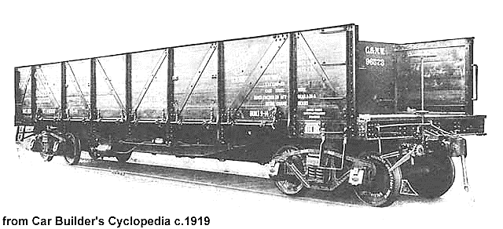

Slide 10
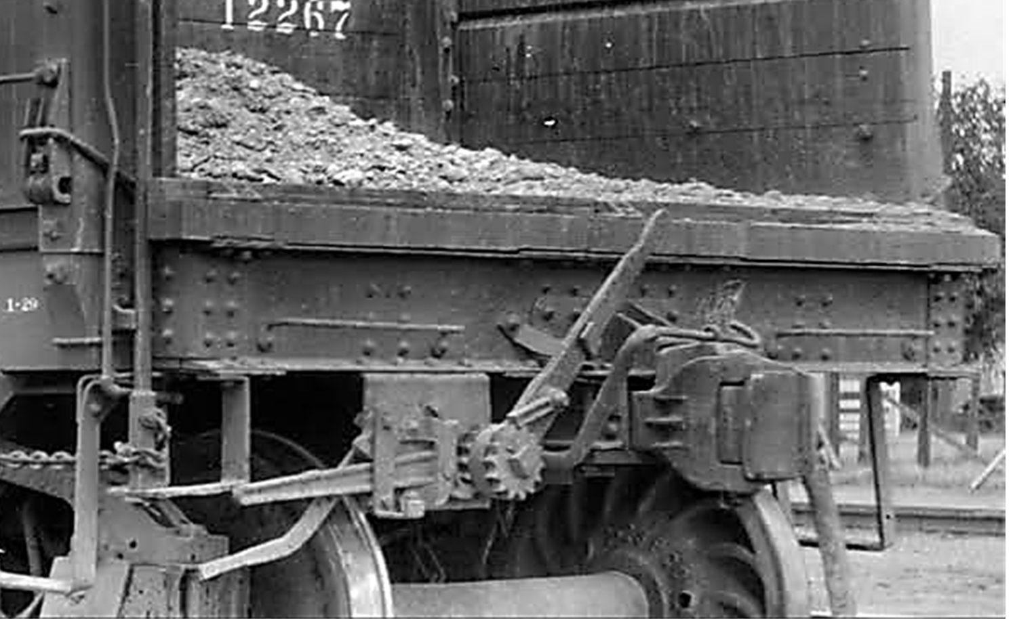

Slide 11
Newbie Revelation: “Convertible” means a railroad can convert the car from a revenue gondola to a nonrevenue ballast car, and back again.
Discussion

Slide 12
Lesson: Hart Ballast Cars Were Innovative and Commercially Successful

Slide 13
Railroads previously used flat cars with removable side boards and sheet-iron aprons bridging between cars. Railroads also used side dump cars.
Harry S. Hart (and others) invented the Hart car. They assigned their rights to the Rodger Ballast Car Co. Rodger licensed to American Car and Foundry and other car manufacturers.
Notes:
Rodger was an employee, director, and likely also an officer. However, he did assign some inventions to others
Rodgers apparently never buit a car.
Sometimes Hart had coinventors, but often not.
Cars are known as both Hart and Rodger cars.

Slide 14
The Hart car was a significant improvement. The inventors were awarded the key patent in 1906. By 1921, at least 60,000 cars were in use by all the larger and most of the smaller railroads.
Here is some information about Hart cars and their operation:
Notes:
Hart was an electrical engineer, but only 1 electrical patent – a battery. I have a photo and bio.
Most of this information re car operation is from the car builder’s cyclopedia. Chapters written by manufacturers, so much puffing an exaggeration.
Also says 70K cars
Had coinventors. Car typically bears his name.
There were prior patents dealing with the structure of the hopper.

Slide 15
Car closest to engine commenced unloading. Others began unloading just before immediately preceding car was empty.
Recommended train speed of approx. 4 mph provided maximum unloading rate of 1car/min.
One employee could operate with “very little practice.”
Notes:
Seems risky
Qouted language is from sales info in maint of way cyclopedia

Slide 16
Lever-operated hopper door obviated need for “easily lost” wrench, and “entirely” eliminated risk of injury.
“Ample” platforms at car ends promoted safety because employees did not have to stand on loads.
Side doors controlled from end of car were operable while car was moving or on trestle.
Notes:
Why would you ballast on a trestle?

Slide 17
Plow car might operate from the end of the train remote from the engine.
Some cars employed “top plows” as follows: (1) An operator closed the hopper door and opened the side doors. (2) The plow was pulled through a line of cars across bridge plates.
Car could dump via hopper and side doors simultaneously.

Slide 18
Some cars employed “supplemental” sides, increasing their load capacity.
Cars were customized to railroads’ needs and specifications.
Cars were used for coal or dirt loads.
Cars were “entirely” self-cleaning via gravity.

Slide 19
Newbie Brain Spark: Injuries and deaths caused by working on the railroad spurred enactment of the Federal Employers' Liability Act in 1908.
Discussion
Notes:
I have more info re this law and its history.

Slide 20
Lesson: Patents Help, But Do Not Provide All the Answers

Slide 21
Hart had about 59 patents, many for ballast or dump cars.
A utility patent excludes others from making, using, or selling an invention for a term of years.
It must contain a specification disclosing and explaining the invention, and claims precisely defining the invention.
Notes:
I have a spread sheet showing all his patents. Sometimes he had coinventors.
The claims went mostly to the cars structure and its ability to support the heavy hopper.

Slide 22
A specification must
(1) contain a written description of the invention,
(2) enable any person skilled in the invention’s art to make the invention, and
(3) provide the best mode for carrying out the invention.
Specifications include drawings.
Notes:
Invention mostly was structure: sills,bolsters, etc. Kit provided structure.
Note this is highly abbreviated and paraphrased

Slide 23
A drawing’s scale must be large enough to show the invention without crowding when the drawing is reduced in size to two-thirds when reproduced.
However, indications such as "actual size" or "scale ½ inch" are not permitted because they may lose meaning when the drawing is reproduced in a different form.
(Above requirements are redacted from
current patent statute & regulations.)

Slide 24
Here are 3 of the 22 drawings contained in the
1906 Patent for the Hart Car
Notes:
He had prior patents going to the design of the hopper. This patent is more concerned with the car’s structure capable of supporting the weight of the hopper and ballast, etc.
THANKS TO STAN WINSTANDLEY

Slide 25
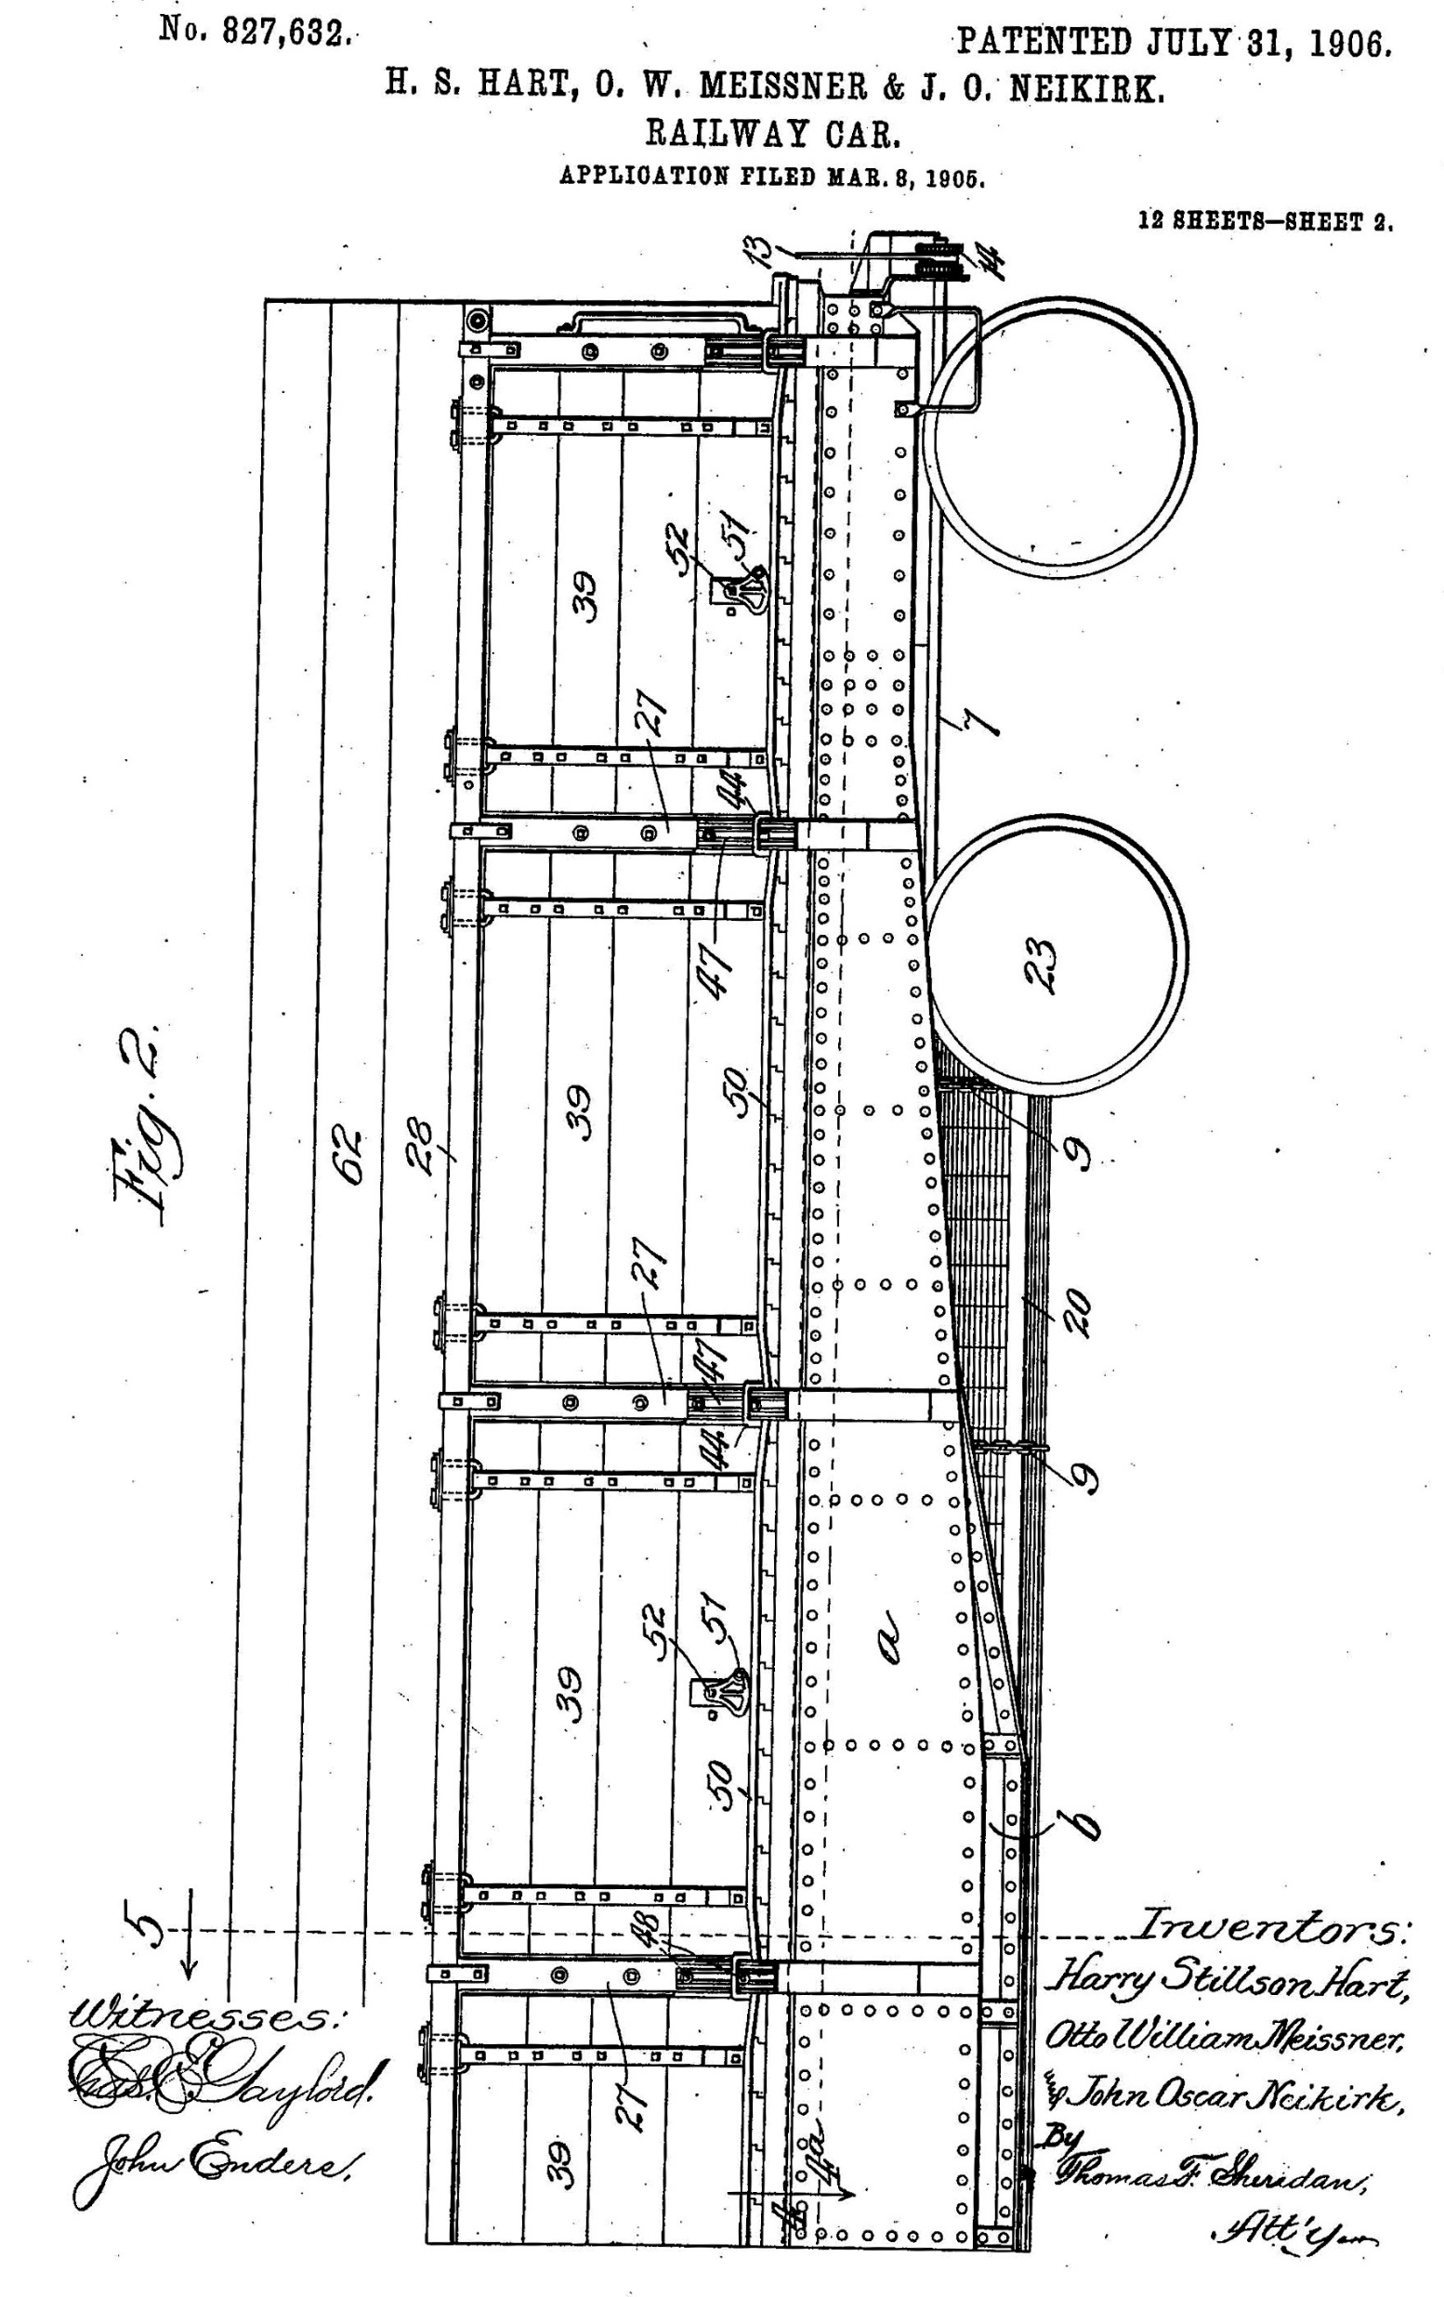

Slide 26
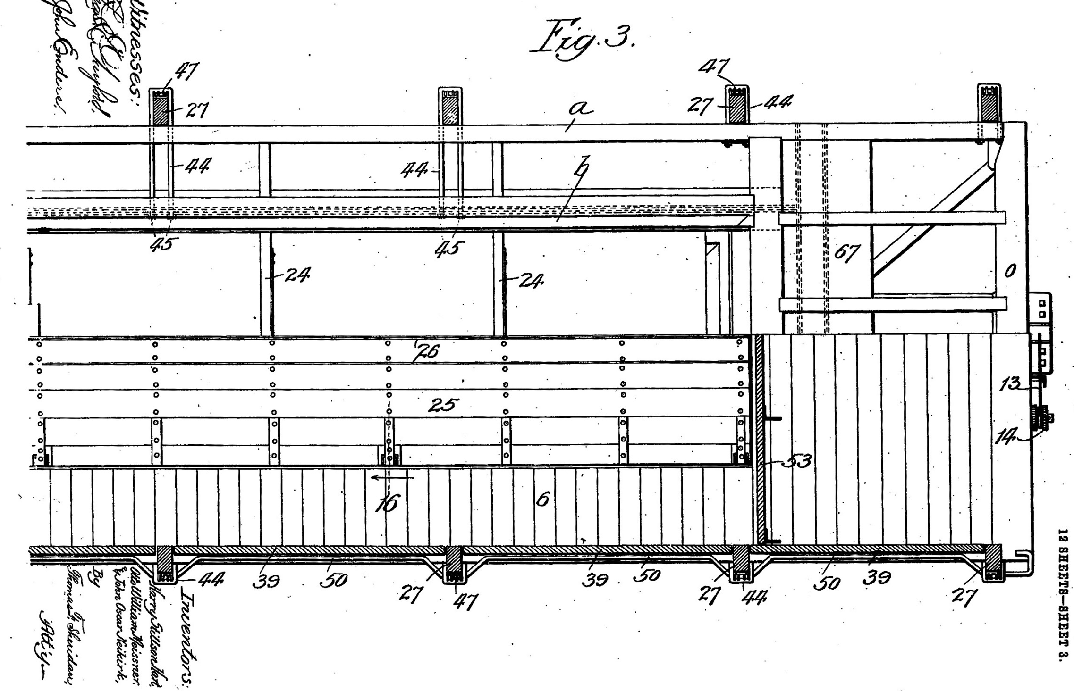

Slide 27
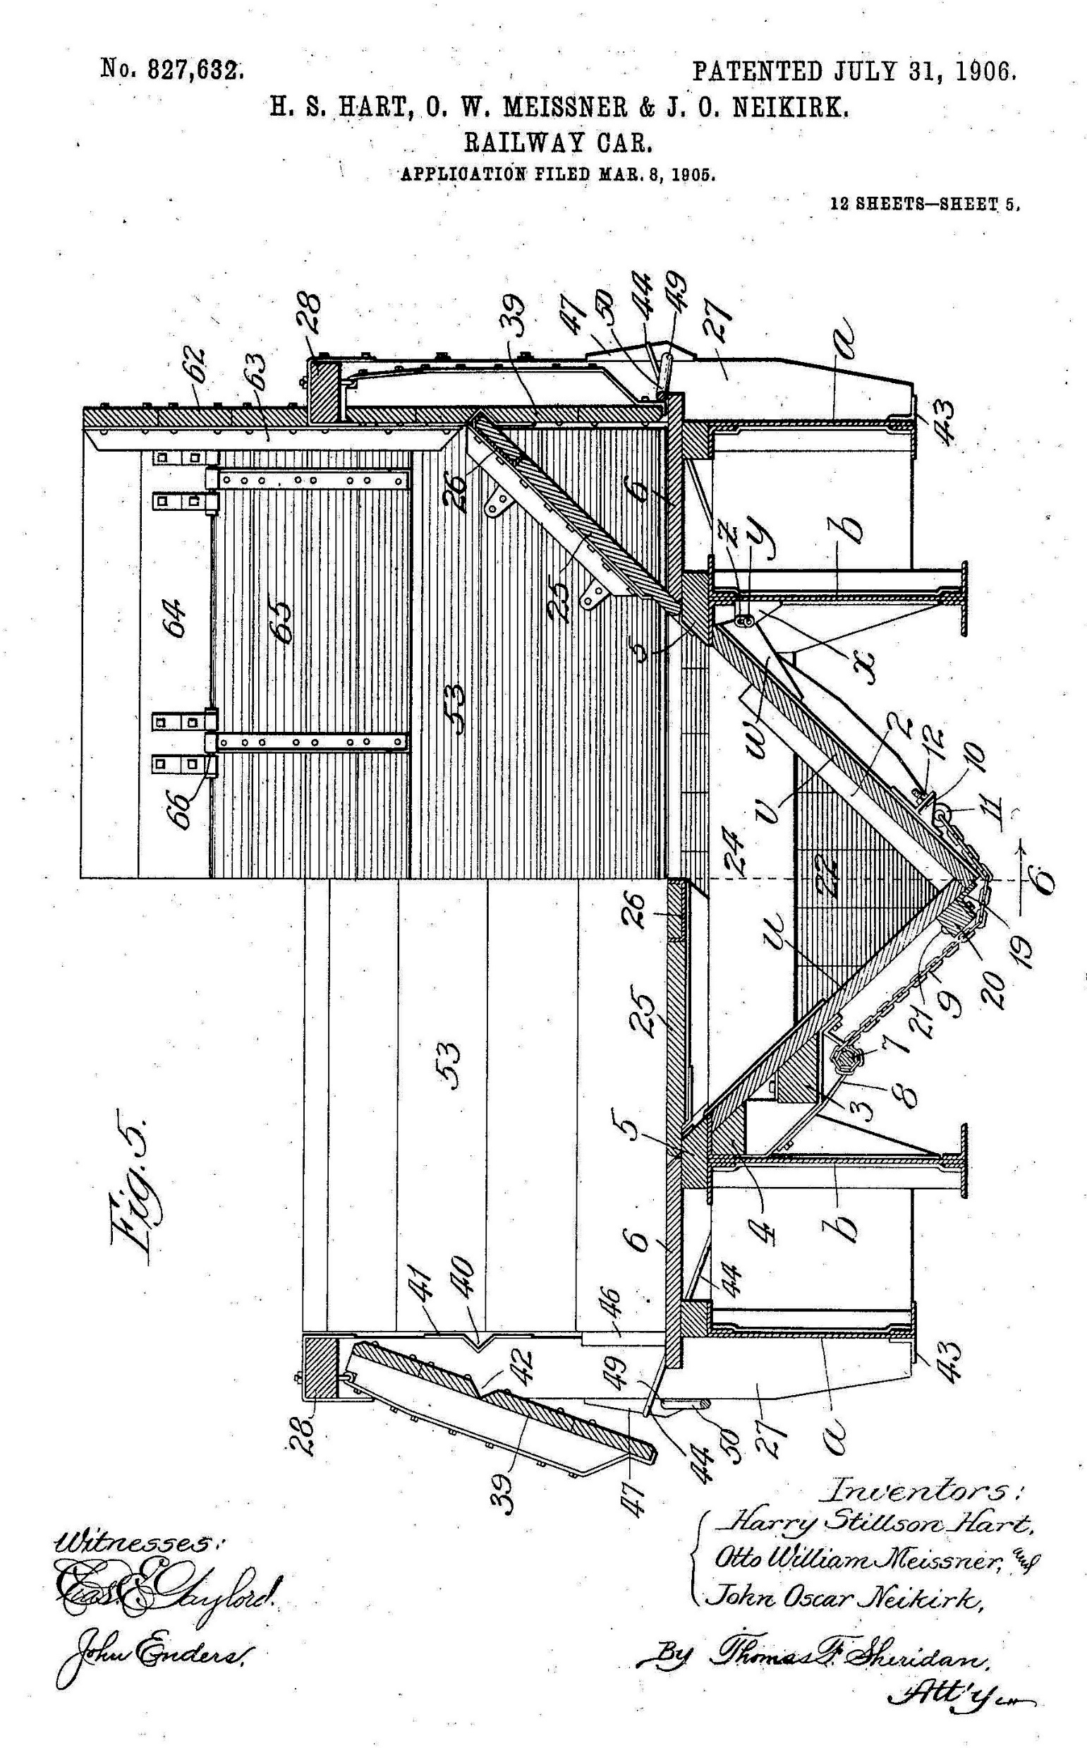

Slide 28
Patents do not reveal everything.
Provide “relative” dimensions (e.g., ratio of length/width), but do not contain a mechanical drawing.
Not required to inform persons lacking ordinary skill in art.
May not disclose “know how,” “trade secrets,” etc.
Do modelers have ordinary skill in the RR car art?
Notes:
Who is a phosita: engineer, shop foremena, line worker?
Trade secrets not too impt because will usuallu goto a process or method. Ie, cannot be reverse engineered.

Slide 29
Newbie Revelation: Track gauge in the US is 4 feet 8 1⁄2 inches between rails.
Therefore, one may approximate RR car size by extrapolating from the distance between the wheels on an axle, or from the rails if they are visible.
Discussion
Notes:
If you like patents, see your nmra calendar.

Slide 30
Lesson: You Can Obtain Information about a Prototype from a Model. (Is This Cheating?)
Notes:
Should I feel dirty?

Slide 31
Dry Creek Models sells a HO kit for the Southern Pacific RR’s version of the Hart car built during 1910-11.
The kit is laser printed and well detailed.
The accompanying instructions and Dry Creek’s web site contain much useful information.
Notes:
SP bought 300 kit comes in open and closed floor versions bottom up view.
The California State Railroad Museum has

Slide 32
Dry Creek’s Robert Bowdidge kindly provided me with prototype photos. Thanks Robert.
The patent described above, plus the bottom of the Dry Creek model Hart car, enabled me to model the car’s hopper mechanism. Here is a photo of my model's rendition.
Notes:
Fra-ge-le

Slide 33
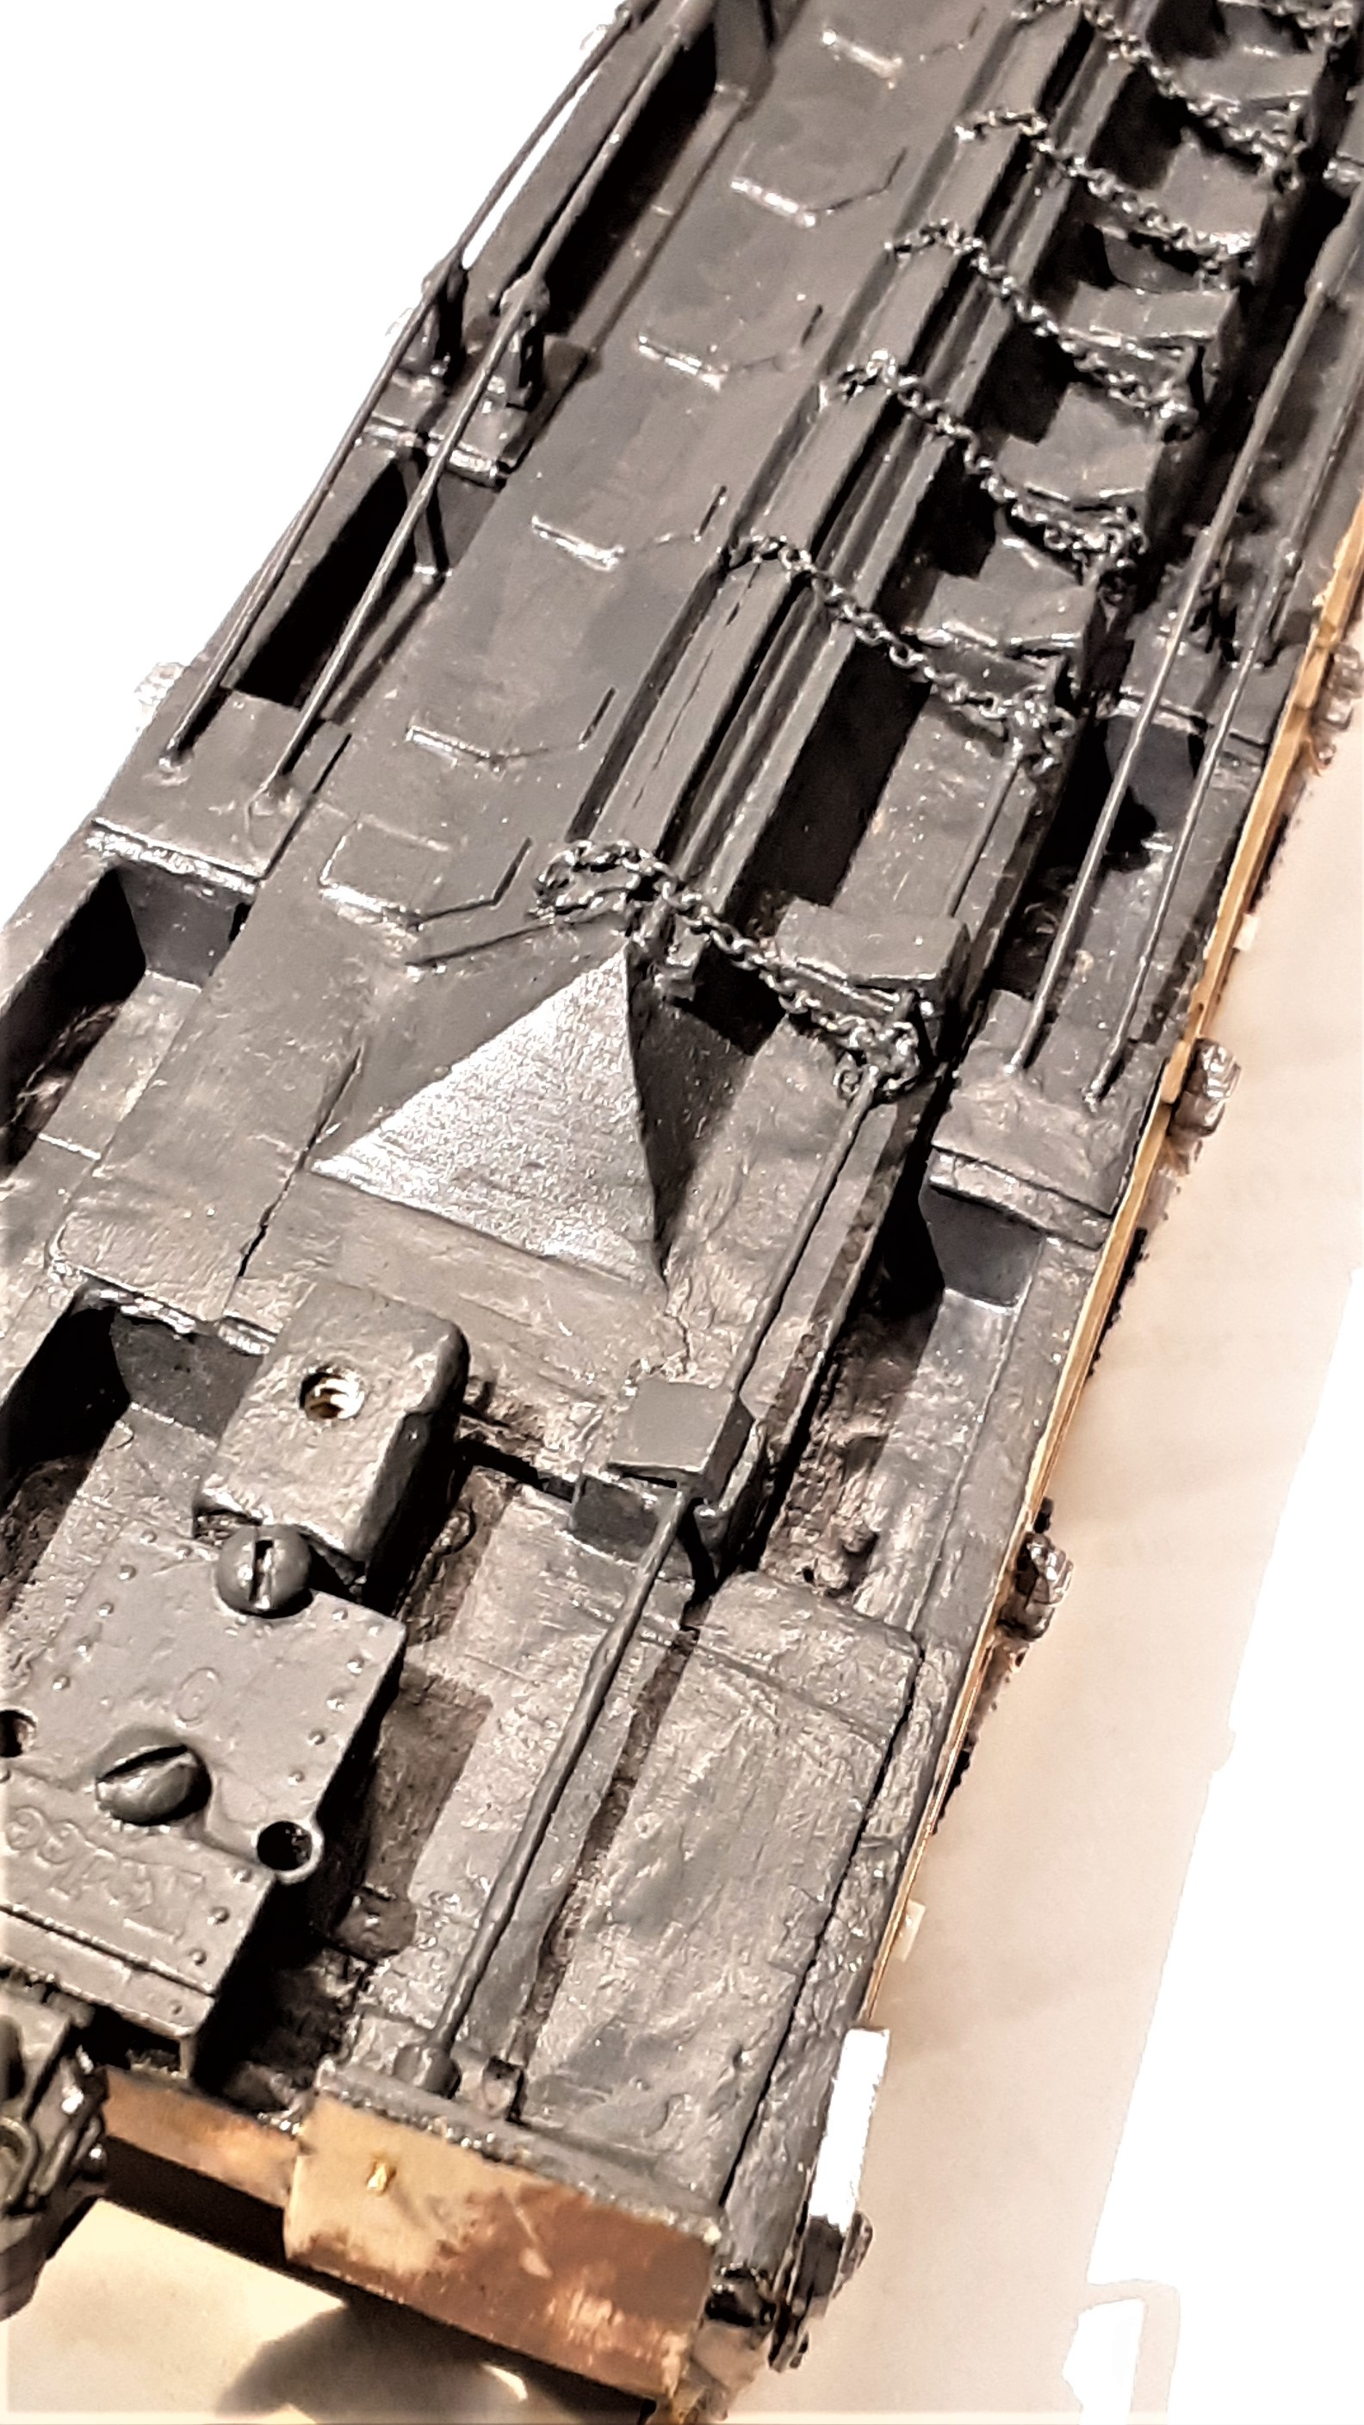

Slide 34
Discussion

Slide 35
Lesson: Wooden Cars Employed Trusses

Slide 36
A truss is a support structure employed to create mechanical stability.
Hart cars employed two truss types.
Truss rods
Bolsters, sills, and cantilevers
Notes:
Hart patented a latter type system. it is somewhat like that on the SP cars.

Slide 37
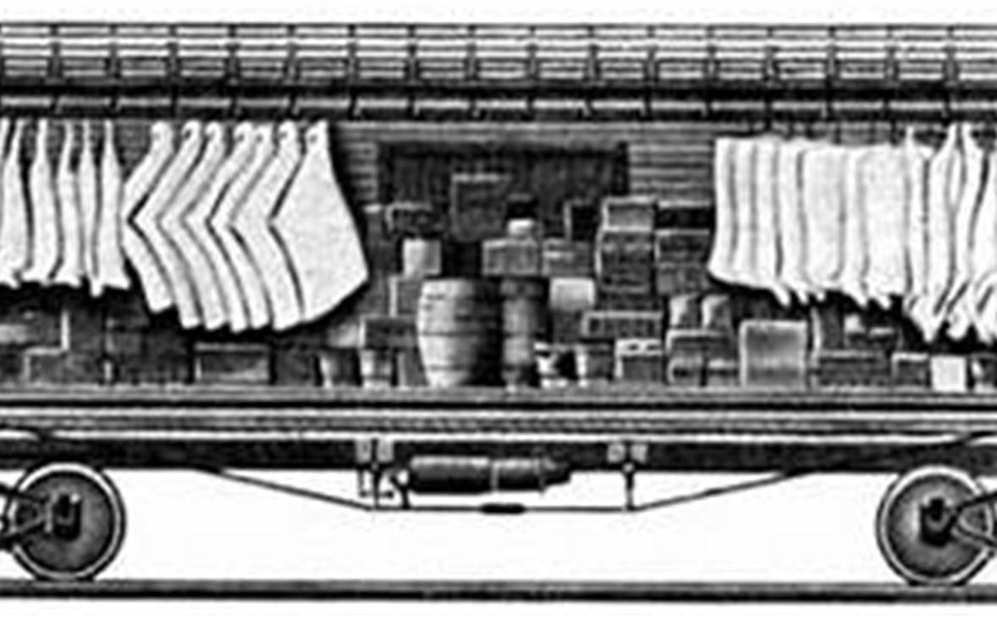
Notes:
I employed wire. Mono filament or thread may have been better and easier to use.

Slide 38
Reproduced with permission of Dry Creek Models
Notes:
Compare roof or floor trusses
Thanks to Robert Bowdige

Slide 39
Discussion

Slide 40
Lesson: Ballast Car Technology Marched On

Slide 41
In 1925, Hart patented a longitudinal hopper for its un-trussed steel “Selective (No Convertible Parts)” ballast car.
Hopper could center dump, side dump left, side dump right, or do all 3 simultaneously.
Versions of this car were manufactured into the 1950’s.
Discussion

Slide 42
Part II: The Modeling Process

Slide 43
Lesson: Everything You Need Does Not Come in the Box

Slide 44
“Craftsman Kit” means “Caveat Modeler.”
What you will, or will not, receive:
Instructions
Materials (mostly bass wood)
Parts (e.g., plastic or metal brake components, grab irons, etc.) (You may want to upgrade these.)

Slide 45
Iron Law # 1: Kit will not provide extra material or parts for mistakes or “escapees.”
Small parts have high potential energy.
Some would be very difficult to make (unless you are Bob Belt).
Flashlight-and-knees recovery method not 100% effective.
Are bibs the answer?
Notes:
Photo of bib, maybe in NMRA magazine.

Slide 46
Iron Law # 2: The kit will not include wheels, trucks, and couplers; and also may not include desirable details such as marker lights. If these are provided, you may want to upgrade.
Iron law # 3: No paint, glue, decals, etc.
Discussion
Notes:
My caboose needed marker lights.

Slide 47
Lesson: Patience, Planning, and Practice Help

Slide 48
Speed kills.
Planning ahead promotes efficiency, and may help to avoid damage to a partially completed model.
Keep a note book.
Measurements
Paint colors
Best techniques
Research and resources
Notes:
Handling is a problem.

Slide 49
If you make parts, always make extras.
Discussion

Slide 50
Lesson: There are Many Sources for Parts and Materials, and Locating What You Need Can Be Fun

Slide 51
In KY:
Hobby Town
Michaels/Hobby Lobby
Berkshire Trains
John Gorman (?)
Wiseman Model Services (Paris)
Scale Reproductions (Louisville)

Slide 52
On-Line:
Kit Kraft
Tichy Train Group
Precision Scale
Micro-Mark (NMRA discount)
ebay
Discussion

Slide 53
Lesson: Scratch Building May Not Be Much More Difficult than Kit Building

Slide 54
A kit may limit your ability to replicate the prototype's structure.
A kit may poorly represent prototype details.
If the kit requires much scratch building, then why not scratch build the entire model?
Discussion
Notes:
You woyou would need some specially parts.uld still need some parts

Slide 55
Lesson: Glues Raise Sticky Issues

Slide 56
Glue types used:
Wood
CA (cyanoacrylate) and accelerator
Epoxy (resin and hardener)
Solvent type for plastics (e.g., Plastruct Bondene)
Other?

Slide 57
The vexing problems of (1) neat application, (2) removal of excess, and (3) mistake correction.
Wood glue may be the least
problematic because it is forgiving
and sandable.
CA glue is more challenging.
Epoxy even more so.

Slide 58
Newbie Cry for Help: What is the best way to solve each of these problems for each type of glue?
Newbie suggestions: Apply (1) CA with a pin point or the tip of a fine wire, (2) CA accelerator with an eye dropper, and (3) plastic solvent with a fine brush.
Discussion

Slide 59
Lesson: Painting is Problematic

Slide 60
Newbie initially used Tru-Color paints.
Pluses: very large selection of railroad-specific colors.
Minuses: employ acetone solvent, and most colors formulated only for spraying, though brushable after allowing some evaporation.
Notes:
Second coat may dissolve 1st coat

Slide 61
Newbie recently began using Testors Model Master acrylic paints.
Pluses: fumes seem less noxious, water cleanup, easier to apply, and better results with brush application.
Minuses: very limited number of railroad-specific colors.

Slide 62
Are there other, perhaps superior, acrylic paints?
Time for an airbrush?
Discussion
Notes:
Is a respirator sufficient for spraing

Slide 63
Lesson: Modeling is Challenging, Sometimes Frustrating, and Almost Always Fun

Slide 64
May take you out of your comfort zone.
You may be better at it now than you were as a kid.
Patience and practice make better.
You can learn from your mistakes.
Set an attainable goal.
You don’t have to be a “bolt counter.”
Don’t worry. Be happy. Enjoy!
Discussion
Notes:
Bring and rag worthy v contest worthy

Slide 65
Conclusion

Slide 66
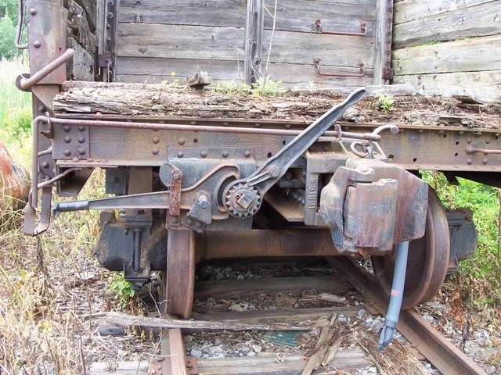
The End
Thanks for Listening!

Slide 67
References and Resources

Slide 68
The Prototype
Railway Prototype Cyclopedia No. 3 (1999)
Hart Selective Ballast Car (Rodger Ballast Car Co. publication circa 1930)
Maintenance of Way Cyclopedia (1921)
Car Builder’s Cyclopedia (circa 1919)
US Patent No. 827,632 (7/31/06) (Hart car)
35 US Code section 112 (patent statute)
37 US Code of Regulations section 1.84 (patent regulations)

Slide 69
www.drycreekmodels.com
http://vasonabranch.blogspot.com/2015/02/printing-freight-car-hart-convertible.html
https://www.midcontinent.org/?s=rodger&x=11&y=6
B. The Modeling Process
Steve Zapytowski, Building the City of Boring (NMRA Magazine, March 2019)
Brooks Stover, Upgrading An Old Style Wooden Craftsman Kit (NMRA Magazine, November 2015)
Member section of NMRA web site
Joe Fugate, Model Railroad Hobbyist’s Guide to Acrylic Painting (mrhmag.com)

